Slide 1




Kurator: Towards Data Curation Workflows for Mere Mortals
An extensible, open-source workflow platform
for users & makers of data curation tools
B. Ludäscher J. Hanken D. Lowery J.A. Macklin
T. McPhillips P.J. Morris R.A. Morris T. Song

Slide 2
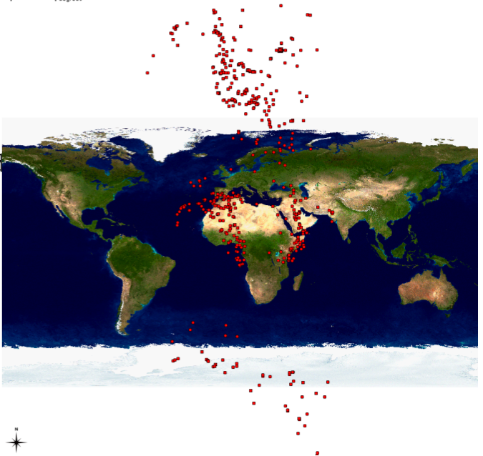



Problem: Data & Metadata Quality
Collections & occurrence data can be all over the map
Examples:
Lat/Long transposition, other geo-ref issues (projections, …)
Scientific Names (spelling errors, other)
Data entry/creation, “fuzzy” data, naming issues, bit rot, data conversions and transformations, schema mappings, …
Related:
Filtered-Push

Slide 3


What problems are we trying to solve?
Detect and flag data quality issues
Repair if possible
… ask human curators as needed
Keep track of provenance
(semi-)automatic repairs
human curators’ edits
Employ workflow (semi-)automation
Scientific workflow systems:
Kepler/COMAD, Restflow, Galaxy, Biovel/Taverna, Argo, VisTrails, …
Related technologies
Akka parallel execution platform
Script-based automation (e.g. Python, R), digital notebooks (iPython)

Slide 4
Customers of Curation Workflows
Collection Managers
… who are managing the collections databases
Can run curation workflows periodically
… in the presence of new data and/or new curation services
(Biodiversity) Researchers
To perform an analysis in the presence of (partially) dirty data, researchers need to
Clean or fix dirty data
Throw out unfixable data
Reporting back to the collection managers (cf. FPush)

Slide 5
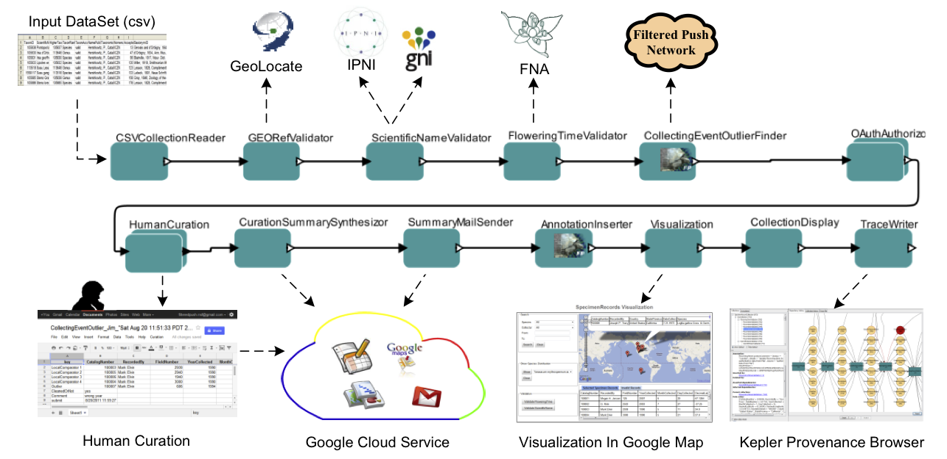
How we do it (Part 1 …): Kepler curation workflows
Dou, Lei., G. Cao, P.J. Morris, R.A. Morris, B. Ludäscher, J.A. Macklin, J. Hanken. 2012. Kurator: A Kepler Package for Data Curation Workflows, Procedia Computer Science, 9:1614-1619, doi:10.1016/j.procs.2012.04.177
Why workflows? ASAP!

Slide 6
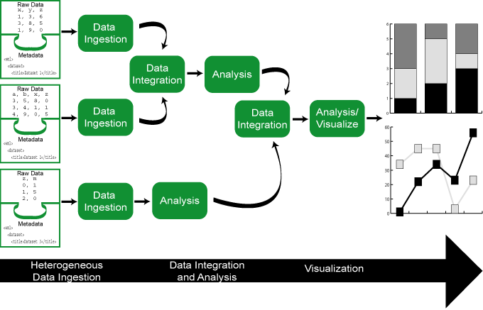
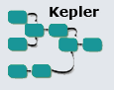






Scientific Workflows: ASAP!
Automation
wfs to automate computational aspects of science
Scaling (exploit and optimize machine cycles)
wfs should make use of parallel compute resources
wfs should be able handle large data
Abstraction, Evolution, Reuse (human cycles)
wfs should be easy to (re-)use, evolve, share
Provenance
wfs should capture processing history, data lineage
➔ traceable data- and wf-evolution
Reproducible Science
VisTrails
Trident
Workbench

Slide 7
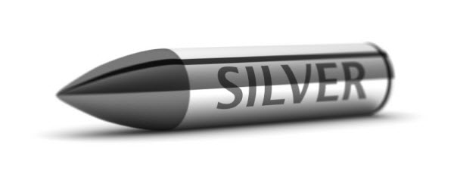
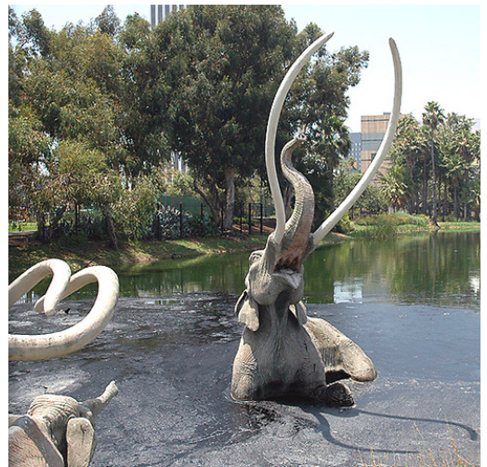
Scientific workflows: a(nother) silver bullet?
Beware of the Turing tar-pit in which everything is possible but nothing of interest is easy.
—Alan Perlis

Slide 8
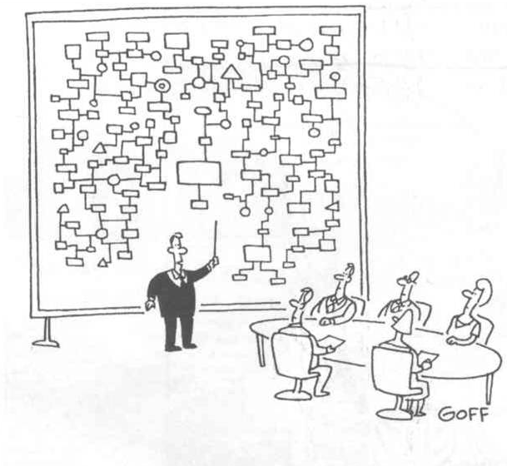
I beg your pardon, I never promised ..
“Thanks to our Graphical UI your scientific workflows will be much easier to develop, understand and maintain!”
Hmm… this was supposed to be easier than programming!

Slide 9
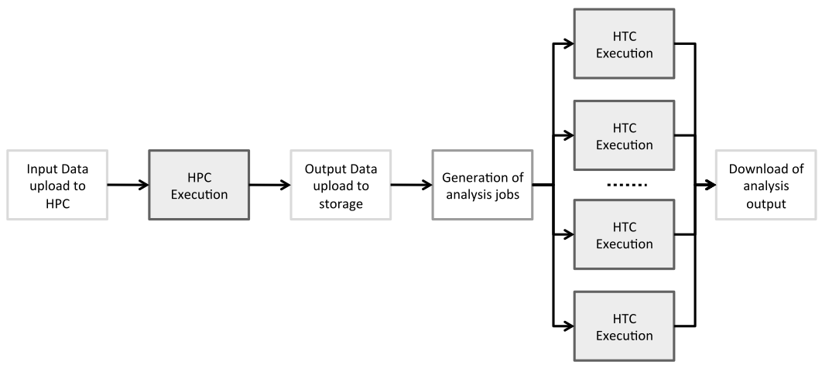
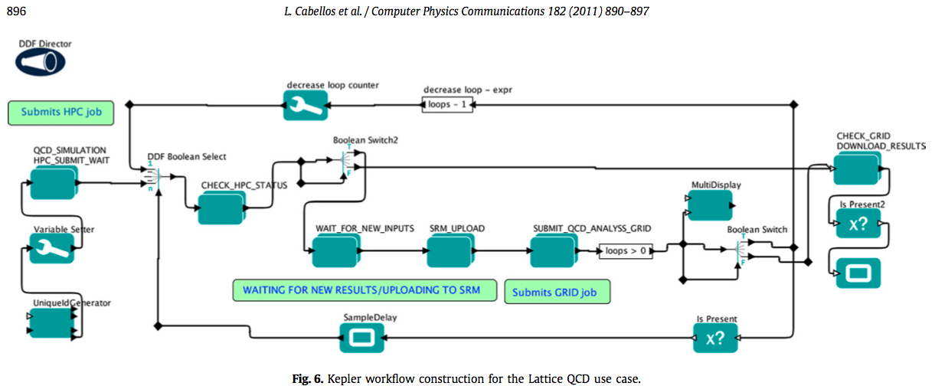
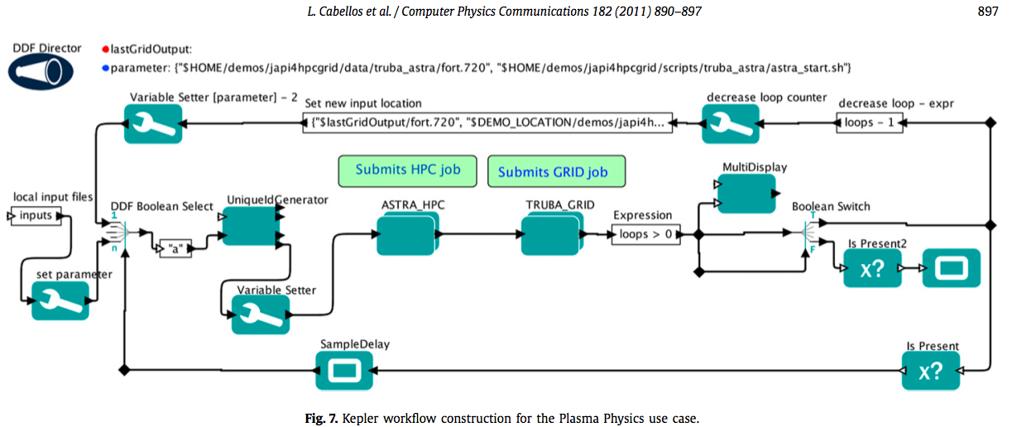
Scientific Workflows …
Cabellos et al. Computer Physics Communications 182, 2011

Slide 10
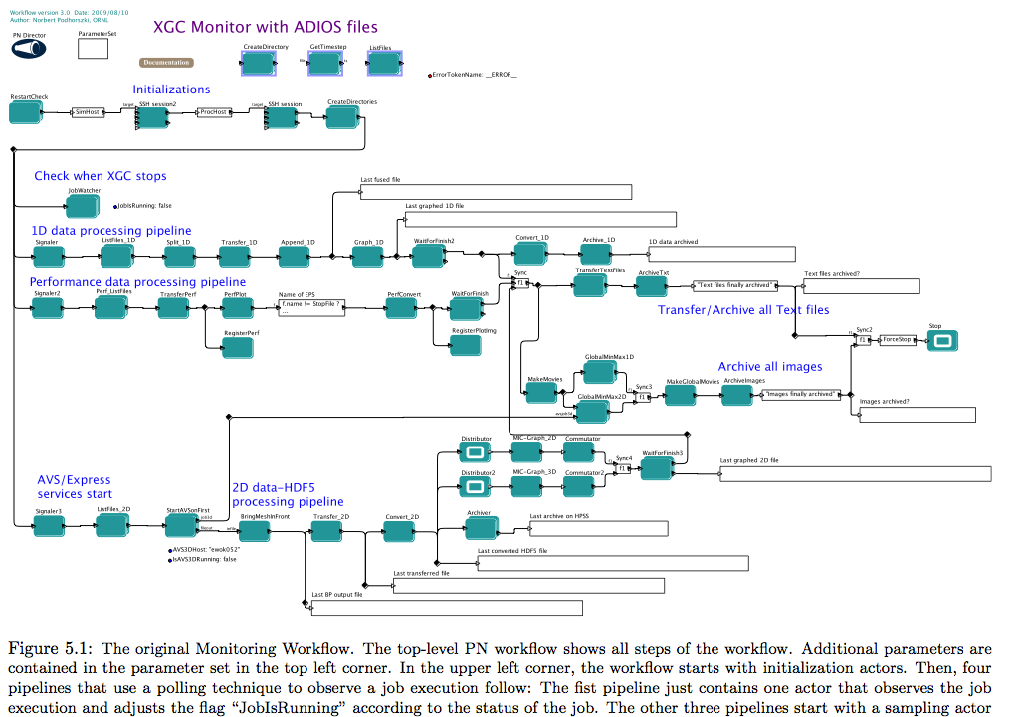
… are a wonderful thing …
Norbert Podhorszki
(then: UC Davis)

Slide 11
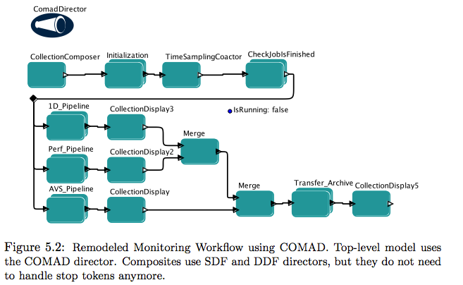
… after simplifying a bit (here: Kepler/COMAD)
Sven Köhler
(then: UC Davis)

Slide 12
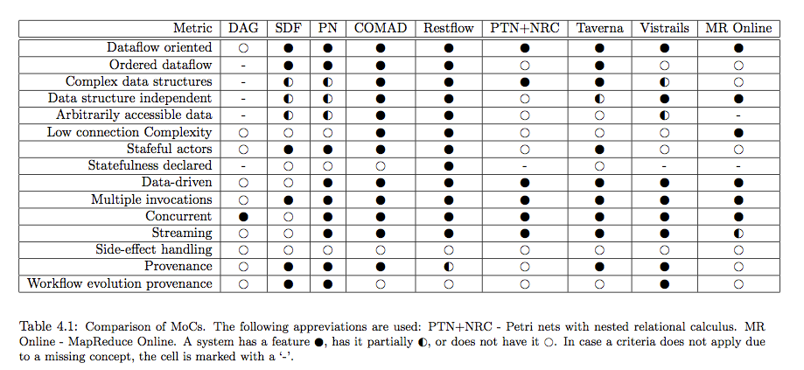
So many systems (models of computation ~ languages, … ) … so little time …
Sven Köhler
(then: UC Davis)

Slide 13
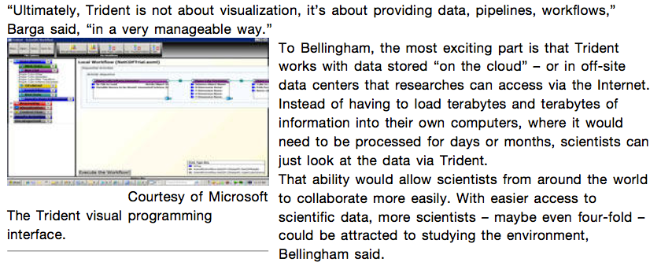
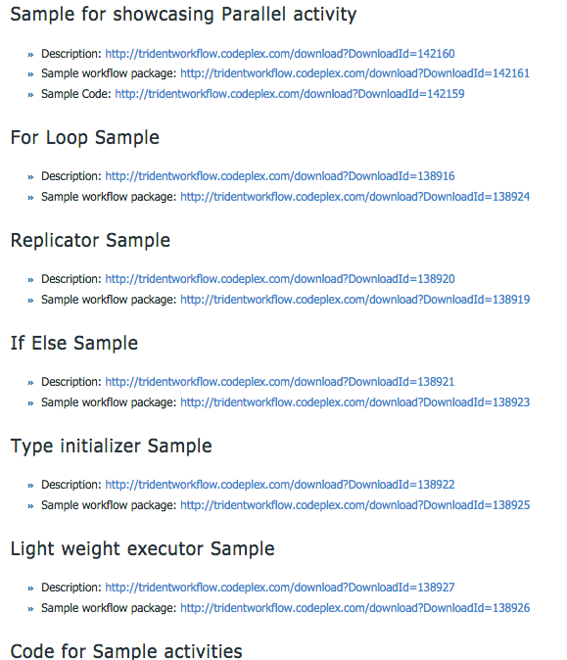
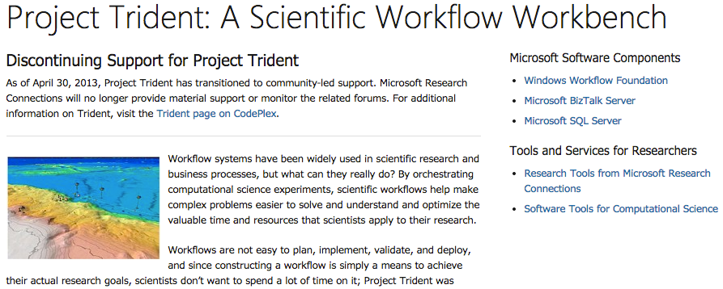
Workflow Systems: Learning to program, all over again …

Slide 14
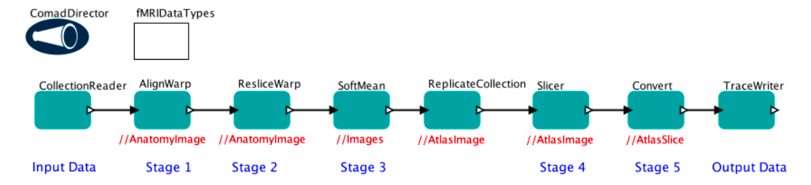
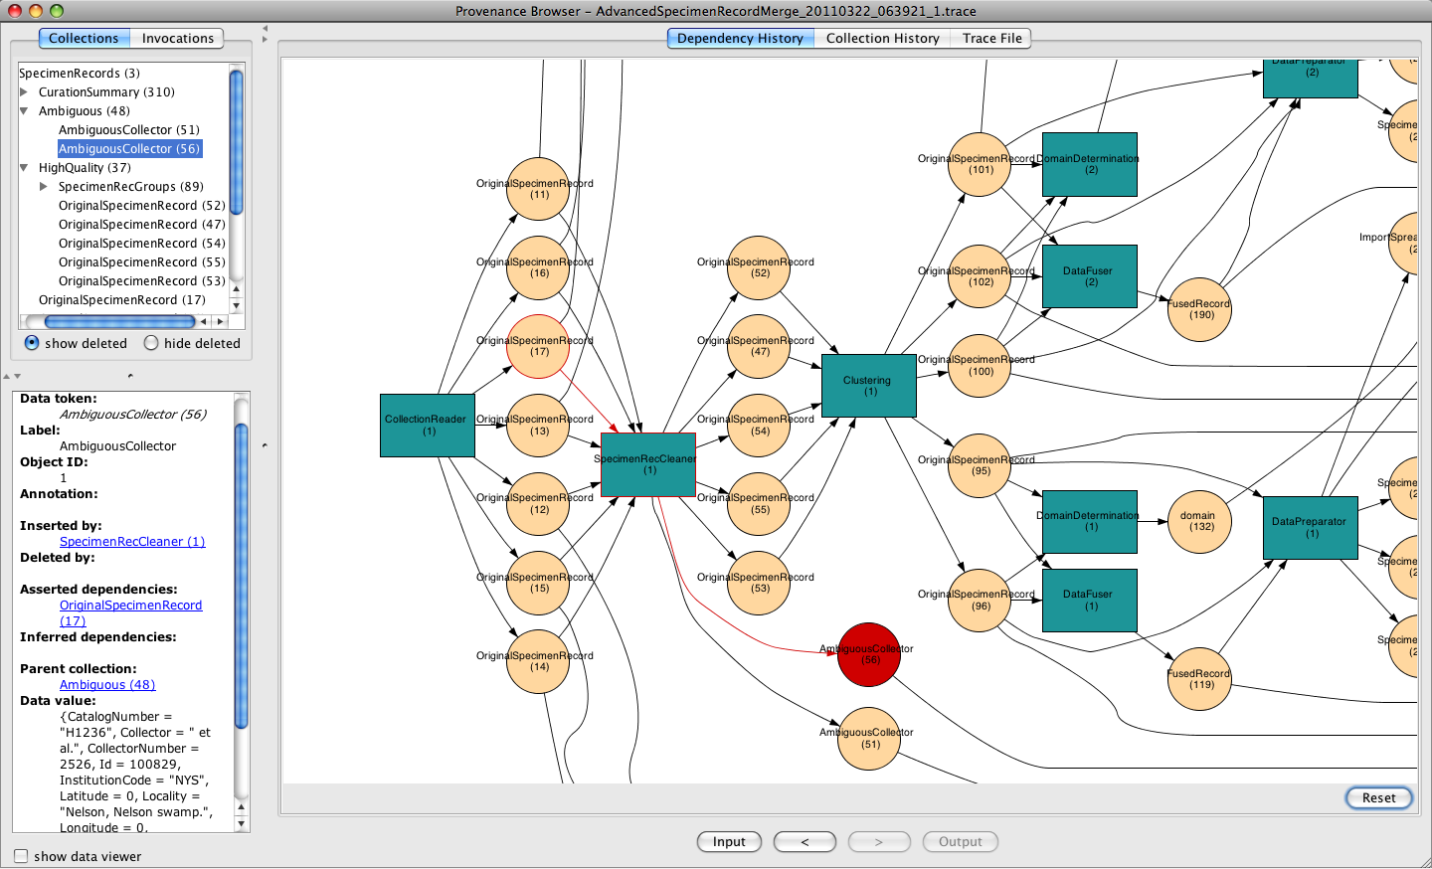
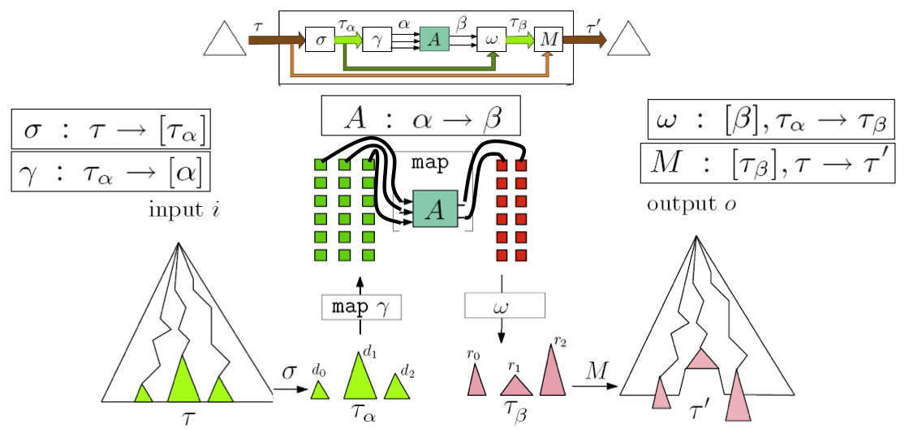
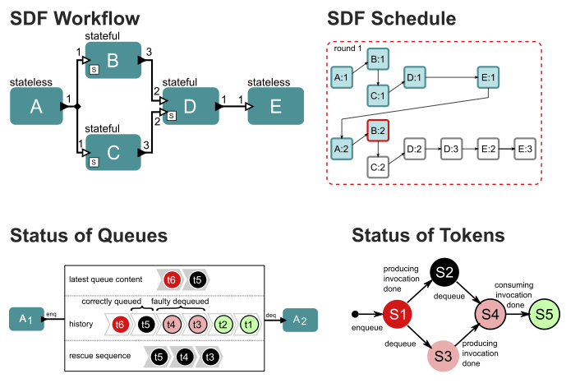
Scientific Workflow: it’s called R&D for a reason …
Workflow Modeling & Design
(prospective provenance)
Runtime Provenance (traces,
retrospective provenance)
Fault-tolerance
crash recovery
Scalability
parallel processing

Slide 15
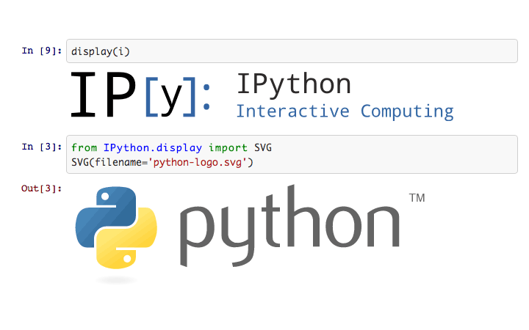
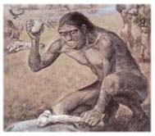
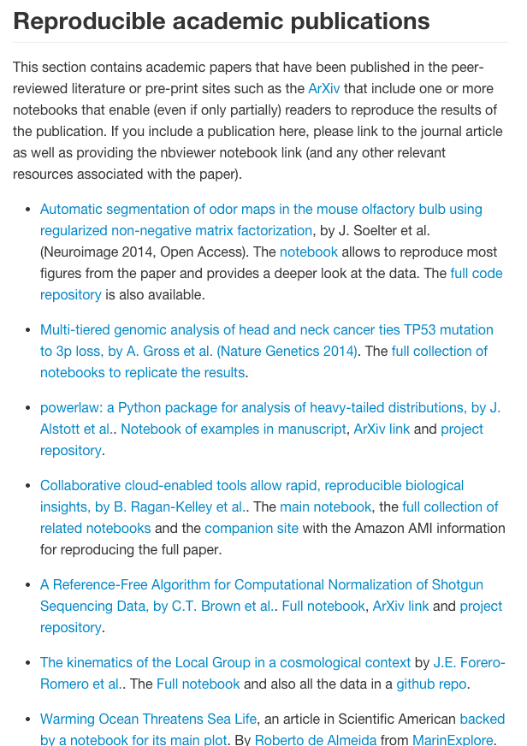
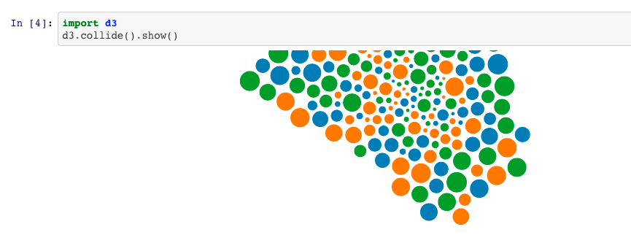
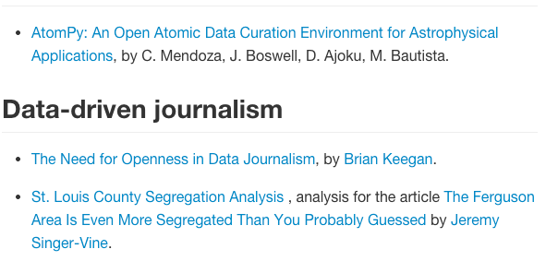
Meanwhile, on a nearby planet …
Highly dynamic visualization
(so dynamic, it’s hard to capture)

Slide 16


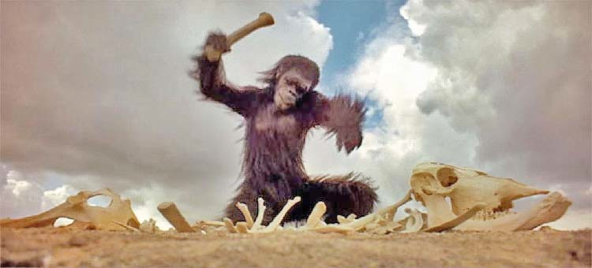

It’s time to Shift Control …
… back from being consumers of tools
“Just click here!”
... to tool makers!
Kurator/P:
Yes, develop for end users …
… but don’t forget the tool makers!
Can we do this together?

Slide 17
How we do it (Part 2 of … )
Kurator
Apply workflow technologies and workflow thinking
… in a technology agnostic way (if possible)
➔ Build a library of curation services such that curation workflows can be run from various platforms
Scientific workflow systems
e.g. Restflow, Kepler, Taverna, Galaxy
Other platforms
e.g. Akka, Python-based, …
… leveraging existing technologies

Slide 18
How we do it (Part 3 of … )
YesWorkflow
Grass-roots effort (goes well with stone-soup…)
Scripts + User annotations
Can give us much of ASAP!
Key Ideas:
Meet the tool makers and researchers (R, Python, …)
Make them workflow/dataflow thinkers …
… but giving them workflow benefits (ASAP!)
… via simple annotations!

Slide 19
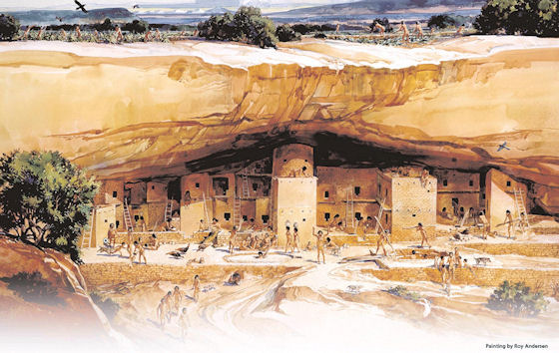
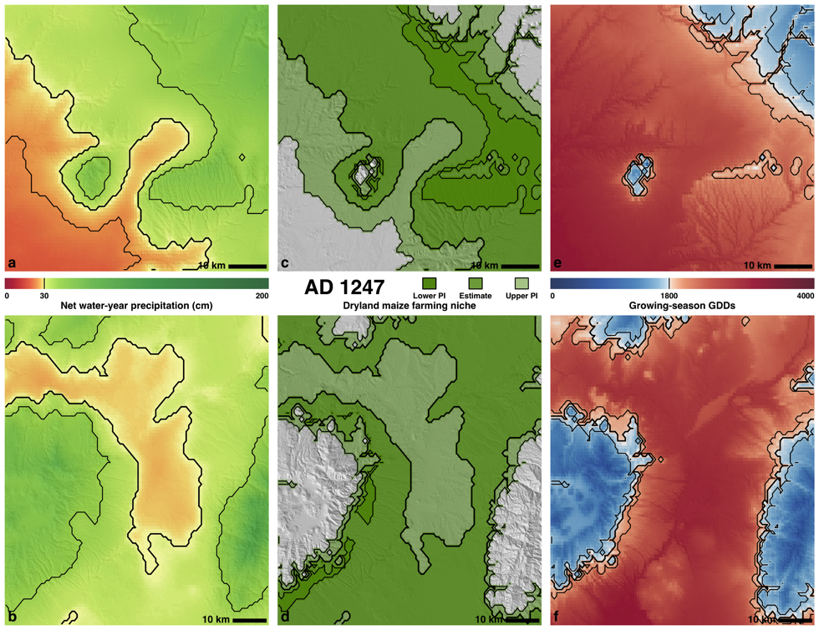
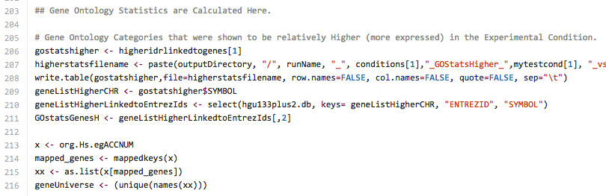
SKOPE: Synthesized Knowledge Of Past Environments
Bocinsky, Kohler et al. study rain-fed maize of Anasazi
Four Corners; AD 600–1500. Climate change influenced Mesa Verde Migrations; late 13th century AD. Uses network of tree-ring chronologies to reconstruct a spatio-temporal climate field at a fairly high resolution (~800 m) from AD 1–2000. Algorithm estimates joint information in tree-rings and a climate signal to identify “best” tree-ring chronologies for climate reconstructing.
K. Bocinsky, T. Kohler, A 2000-year reconstruction of the rain-fed maize agricultural niche in the US Southwest. Nature Communications. doi:10.1038/ncomms6618
… implemented as an R Script …

Slide 20
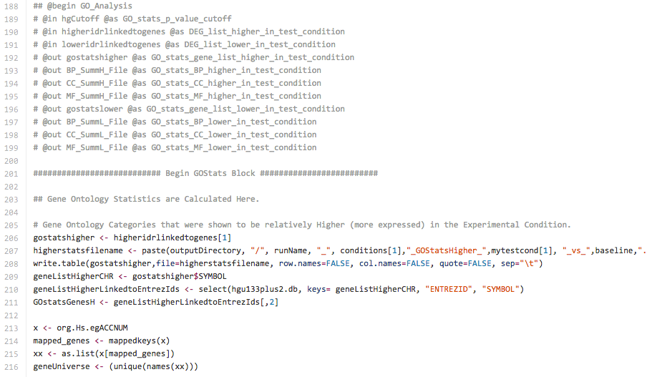
User Comments: YW Annotations
@begin GO_Analysis
@in hgCutoff
@in …
@out BP_Summl_file
@out …
@end GO_Analysis
...

Slide 21

Get 3 views for the price of 1!
Process view
Data view
Combined view

Slide 22
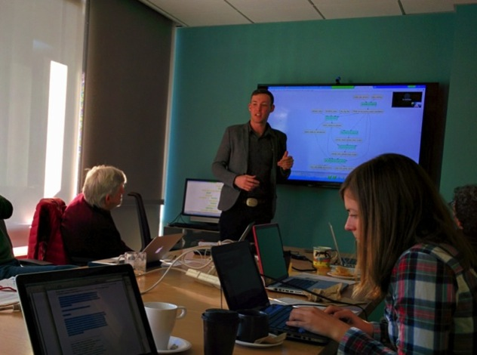

Paleoclimate Reconstruction (EnviRecon.org)
… explained using YesWorkflow!
Kyle B., (computational) archaeologist:
"It took me about 20 minutes to comment. Less than an hour to learn and YW-annotate, all-told."
SKOPE
+
Kurator
+
=> YesWorkflow.org

Slide 23
The Road ahead …
YesWorkflow:
… finishing support for retrospective provenance without using a runtime provenance recorder!
Key insight: scientists already leave provenance “bread crumbs” behind! (it’s not an accident!)
Exploit that via annotations: URI-templates
Kurator[/P]:
How far can we go towards ASAP via YW?

Slide 24
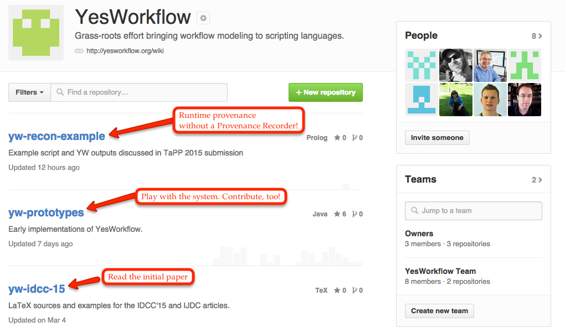
YesWorkflow.org

Slide 25
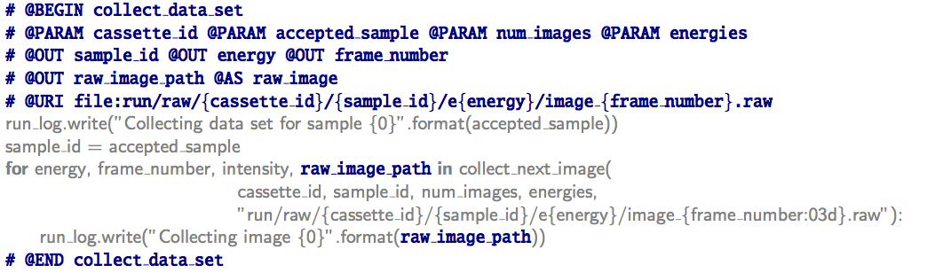
YW-RECON: Prospective & Retrospective Provenance … (almost) for free!
YW
YW annotations in the script (R, Python, Matlab) are used to recreate the workflow view from the script …

Slide 26
YW-RECON: Prospective & Retrospective Provenance … (almost) for free!
URI-templates link conceptual entities to runtime provenance “left behind” by the script author …
… facilitating provenance reconstruction

Slide 27
Summary: Data Curation with Scientific Workflow Systems
Scientific Workflows
[+] Automation
[+] Scalability
[+] Abstraction
[+] Provenance
…
[+/0] Easy to use
[0] learning a new paradigm
[-] Teaching resources: learning a new language!
[-] Special expertise needed for deep changes
e.g. new Java actors, shims, …

Slide 28
Kurator/P: Scripts + YesWorkflow ++
Scripts: [+] Automation, [0] Scalability, [-] Abstraction, [0/-] Provenance
Now: Scripts + YesWorkflow Annotations
[+] Abstraction
explain your methods to mere mortals
=> encourage (re-)use
[+] Provenance:
YesWorkflow (prospective and retrospective provenance)
[+] Language independent (R, Matlab, Python, …)
[+] Empower tool makers (script programmers): give them …
… some immediate benefits (workflow views, retrospective provenance)
… some long term benefits: think about your methods differently
=> dataflow programming => [+] Scalability

Slide 29

Acknowledgments
NSF-DBI #1356751
Collaborative Research: ABI Development: Kurator: A Provenance-enabled Workflow Platform and Toolkit to Curate Biodiversity Data

Slide 30
Additional Material

Slide 31
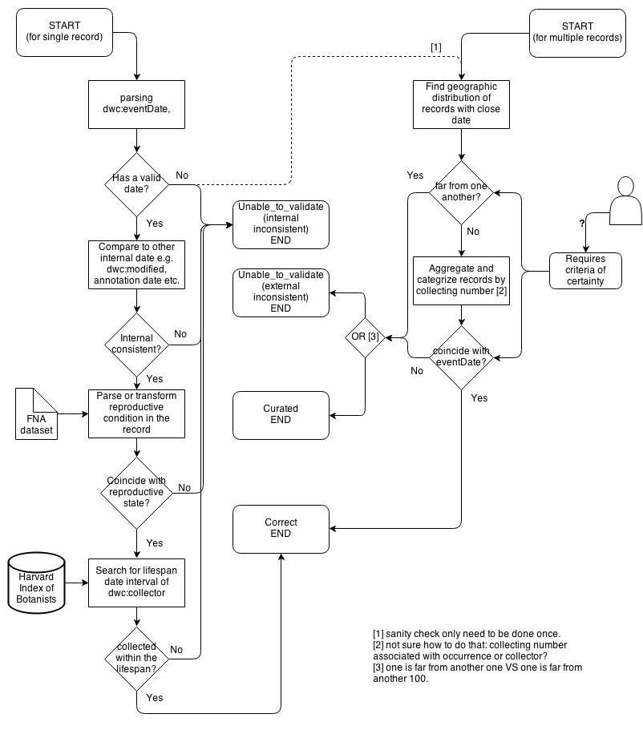
Date Validation
Check:
Collector’s life span
.. vs. Date-Collected
Possible outcomes:
Valid
Corrected
Unable to validate
Internal inconsistency
Contradicting dates
External inconsistency
Lack of date data

Slide 32


… Logic Behind Each Step (cont’d)
Scientific Name Validation
Customer-dependent:
Collection Managers:
Nomenclature
Researchers:
Taxonomy (current names)
Several Remote services
IPNI, GNI, …
…. <your logic here> …

Slide 33
Simplified Example Workflow
Allow easy assembly of such workflows
For tool makers
… and tool users
… scalability …
Related Research (Tianhong Song, UC Davis)
Analyze linear workflow “story”
Use patterns to discover wf design issues (e.g. use before update); then fix them
Parallelize when possible

Slide 34
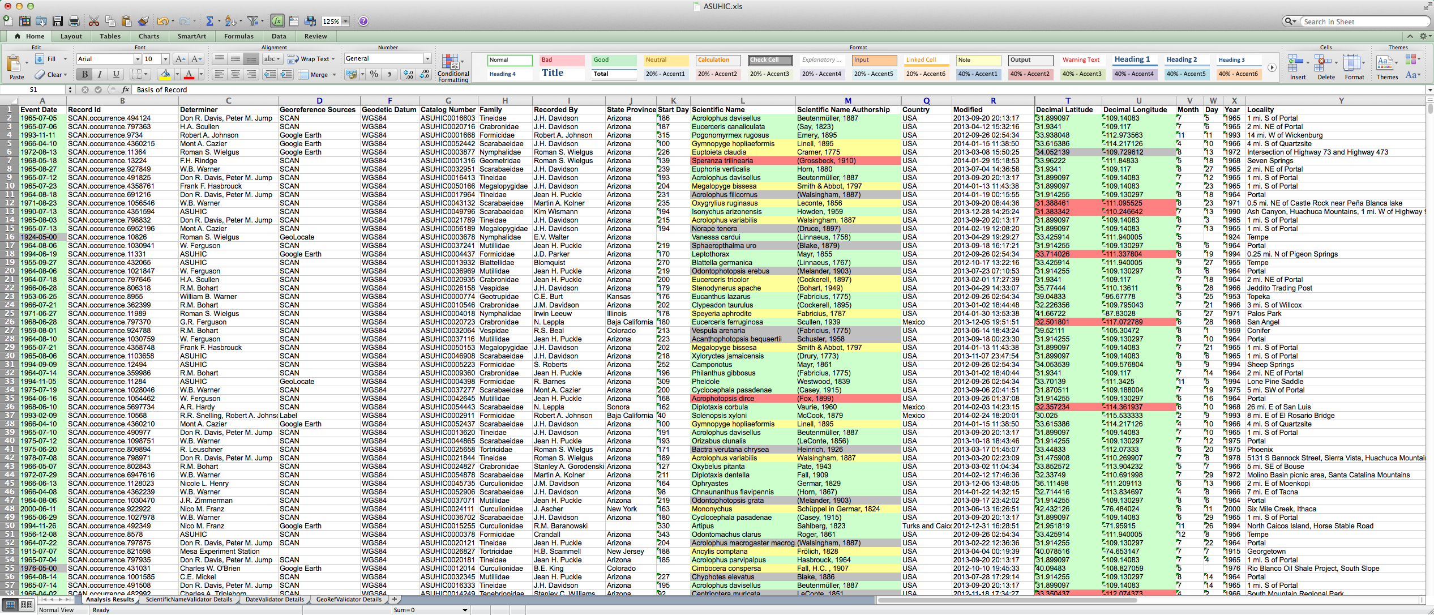
Example Output …

Slide 35
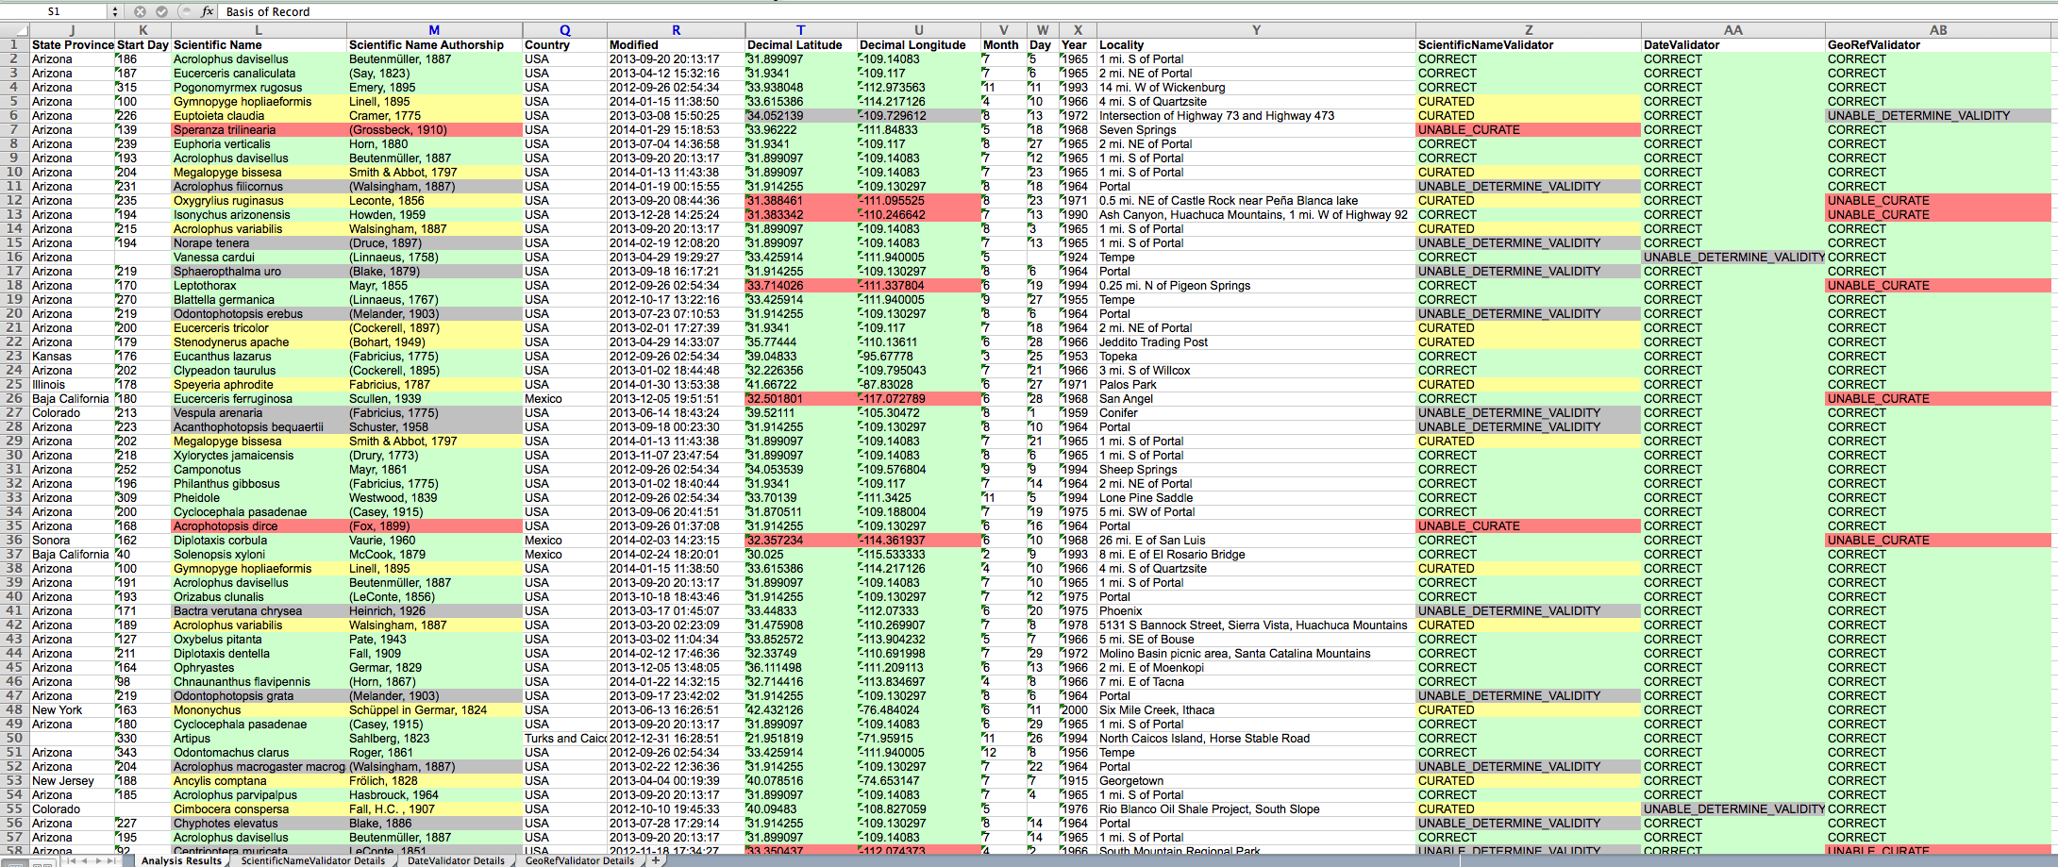
… close up …

Slide 36
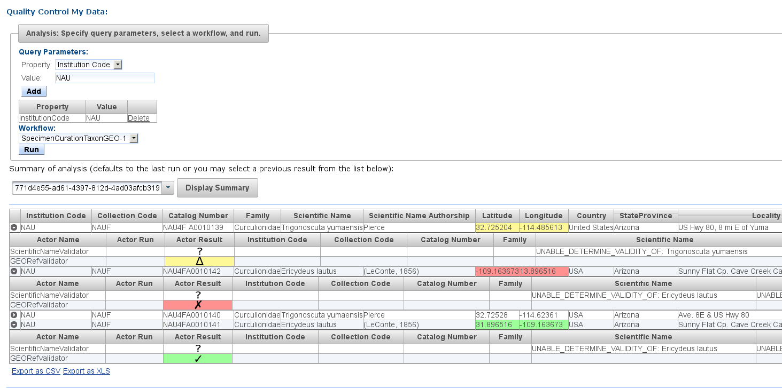
FilteredPush Curation Provenance (Spreadsheet View)

Slide 37
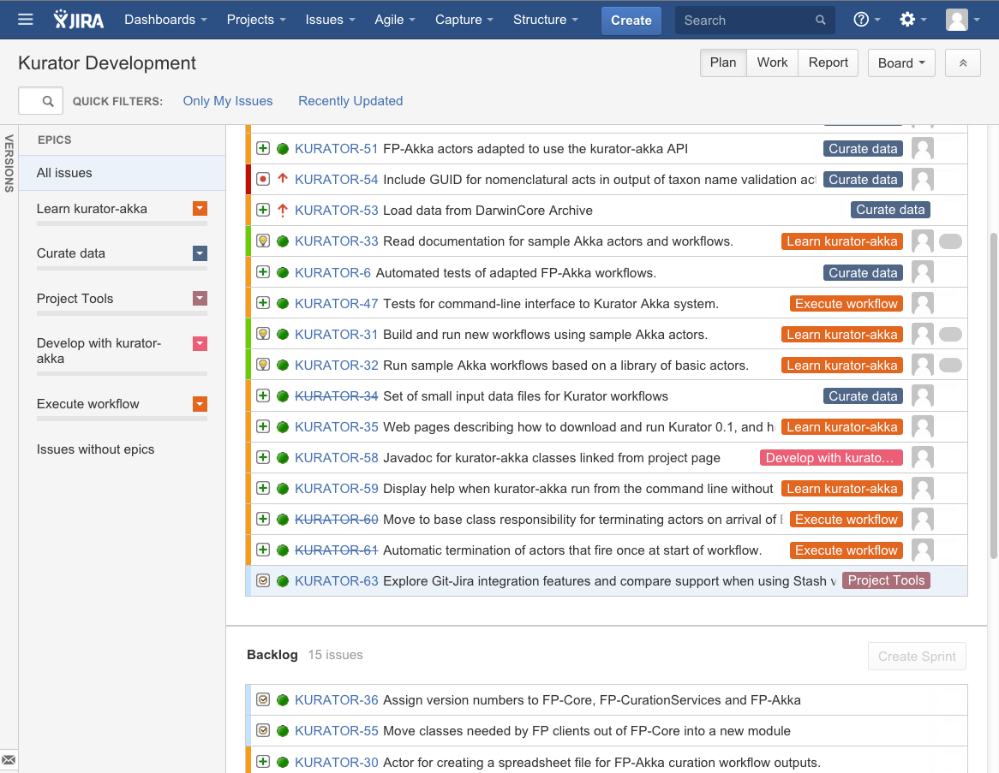
Agile Kurator Development

Slide 38
Related Research (Tianhong Song, UC Davis)
Analyze linear workflow “story”
Use patterns to discover wf design issues (e.g. use before update); then fix them
Parallelize when possible

Slide 39
Contact me!
If you’re interested in a project, research theme (or similar ones): Send me email!
Email: ludaesch@illinois.edu

